Slide 1

Hospital Timesheet App: “MyTime”
Jennifer Lycke

Slide 2
Project overview
The product:
“MyTime” is a smartphone hospital timesheet application for hospital employees with irregular hours and multiple job sites.
Project duration:
May 2021 – July 2021

Slide 3
Project overview
The problem:
Hospital employees with irregular job schedules or multiple job site locations found it difficult to track their work time. They often forgot to log their time, especially when being called in at the last minute or having to travel to alternate job sites. This resulted in timekeeping inaccuracies, wasted time and stress, and extra work for timekeeping administrators.
The goal:
The goal is to make it easier for hospital employees to remember to track their time, or to enable the app to track their time automatically based upon GPS, depending upon the user’s preference.

Slide 4
Project overview
My role:
UX researcher and UI designer
Responsibilities:
- User research
Wireframing (low fidelity and high fidelity)
Prototyping (low fidelity and high fidelity)
User testing and analysis

Slide 5
User research
Personas
Problem statements
User journey maps
Understanding
the user

Slide 6
User research: summary
I performed a Moderated Usability Study with 5 hospital employees each in 2 rounds of user testing. In the 1st round of testing, users were asked to interact with a low-fidelity prototype presented on a smartphone and were verbally asked a series of prompts and prompt follow-up questions. In the 2nd round, users were asked to perform additional tasks with a high-fidelity prototype. Assumptions going into user testing were that the app would be helpful to hospital employees and that the app was easily to navigate. Overall, the testers confirmed these assumptions and were pleased with the app capabilities. However, there were some issues raised when it came to filling out timesheets. Based upon this feedback, these issues were corrected with multiple iterations of design updates.

Slide 7
User research: pain points
1
2
3
Doctors can get called into work at various hours of the day or night. This makes it hard to remember to log work time.
Mobile employees are always on-the-go and have multiple job sites, which can make tracking time more difficult
Users must go into the main office to request time off on a desktop computer
Enabling reminders and automatic timekeeping based upon GPS location will be included capabilities in the app design.
Enabling reminders and automatic timekeeping based upon GPS location will be included capabilities in the app design. For manual timekeeping, the app will have easily visible large buttons on the home page to start/stop work time.
Users found it helpful to be able to request time off through the phone app, instead of having to rely on the computer at work. The design will include a menu option to enable users to easily request time off.

Slide 8
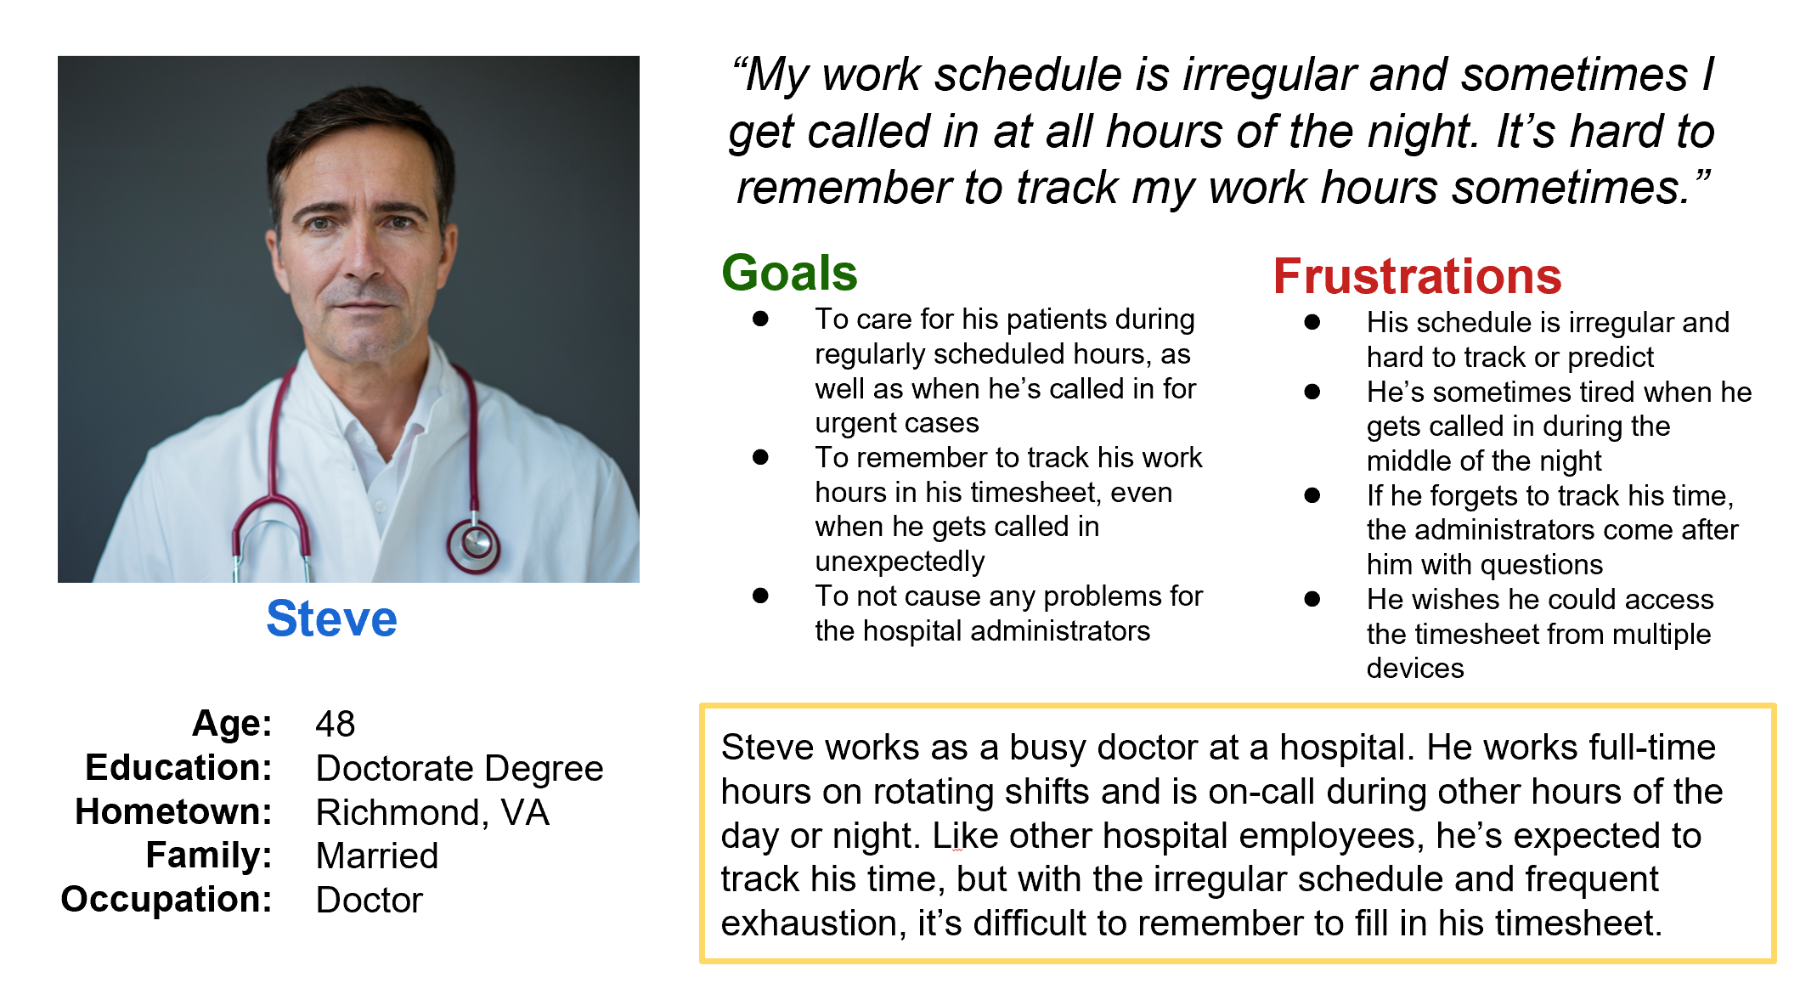
Persona: Steve
Problem statement:
Steve is a busy doctor
who needs to accurately track his irregular work schedule
because he sometimes forgets when he gets called into work at all hours of the night.

Slide 9
ACTION | Start Work | Punch-In | Continue Workday | Punch-Out | Leave Work
TASK LIST | Tasks A. Get showered and dressed for work B. Walk to home office C. Bring smart phone to home office | Tasks A. Remember to punch-in B. Log in on timesheet app C. Check current time from wall clock D. Enter start time in app E. Click Save | Tasks A. Drive to patients’ homes to help care for them throughout the day B. Take breaks in the car as necessary between patients | Tasks A. Remember to punch-out B. Go to app C. Double-check that necessary hours have been worked D. Check current time from phone or car clock D. Enter finish time in app E. Click Save F. Log out | Tasks A. Drive from last patient’s home B. Arrive home C. Enjoy evening
FEELING ADJECTIVE | Groggy Sleepy Eager | Groggy Sleepy Eager Frustrated if forgot to bring phone or to punch-in on time | Content Productive Ready to leave work | Ready to leave work Excited Tired Frustrated if forgot to punch-in or punch-out on time | Tired Relieved Content Excited
IMPROVEMENT OPPORTUNITIES | -Set up visual, audio, and haptic (all 3 for accessibililty) alert on phone as reminder to bring phone -optionally connect to Alexa for reminders | -App can automatically pull in current time to make it easier. -Visual/audio/haptic reminder -optionally connect to Alexa for reminders | -GPS on app can monitor where she is, so hospital can track and so she can find new patients’ homes -app shows current hours worked in real-time as day goes by | -App can automatically pull in current time to make it easier. -Visual/audio/haptic reminder (all 3 for accessibility) -big buttons to log time easily from car (glare, distractions, etc.) | -Easy to read confirmation (big green checkmark) that time has been entered successfully for the day -Total hours for the day and week calculated and easy-to-read
User journey map
I listed out the detailed tasks in chronological order that our personas need to perform, in order to understand the process and empathize with pain points. This helped determine how the app should work and how it can resolve these pain points.

Slide 10
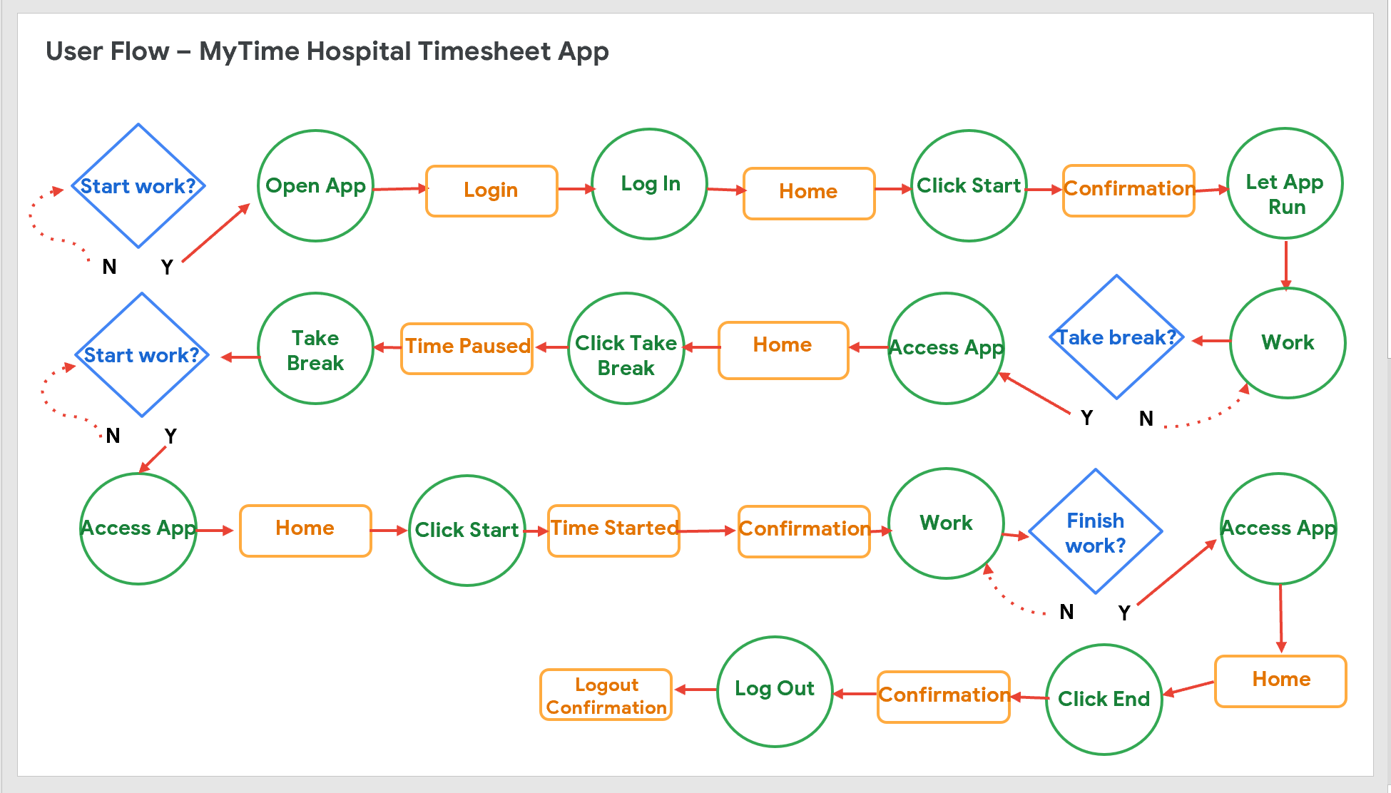
User flow
I thought through the logical order of the tasks that user must complete. This helped determine how the app should work and how it can resolve their pain points.

Slide 11
Paper wireframes
Digital wireframes
Low-fidelity prototype
Usability studies
Starting
the design

Slide 12
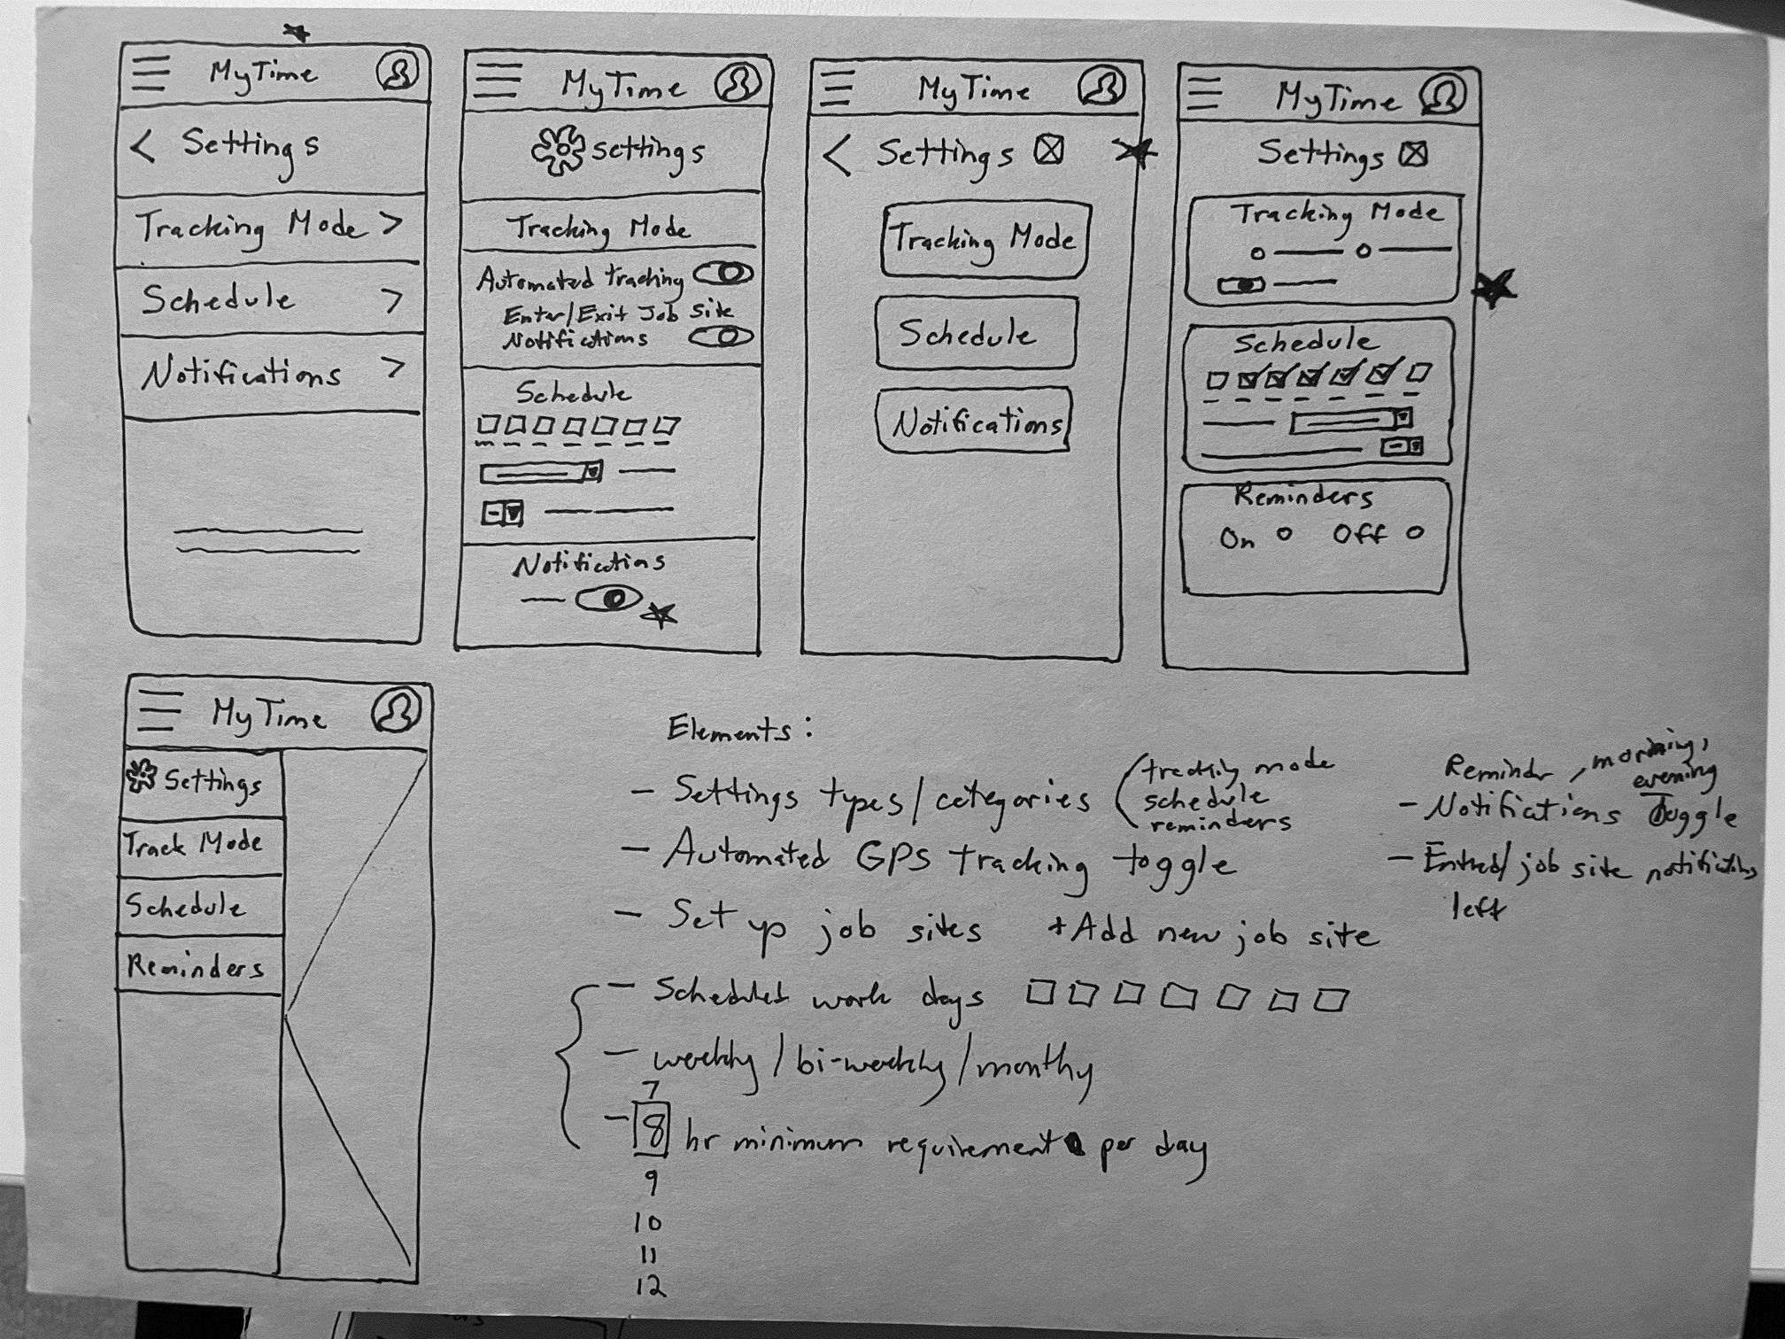
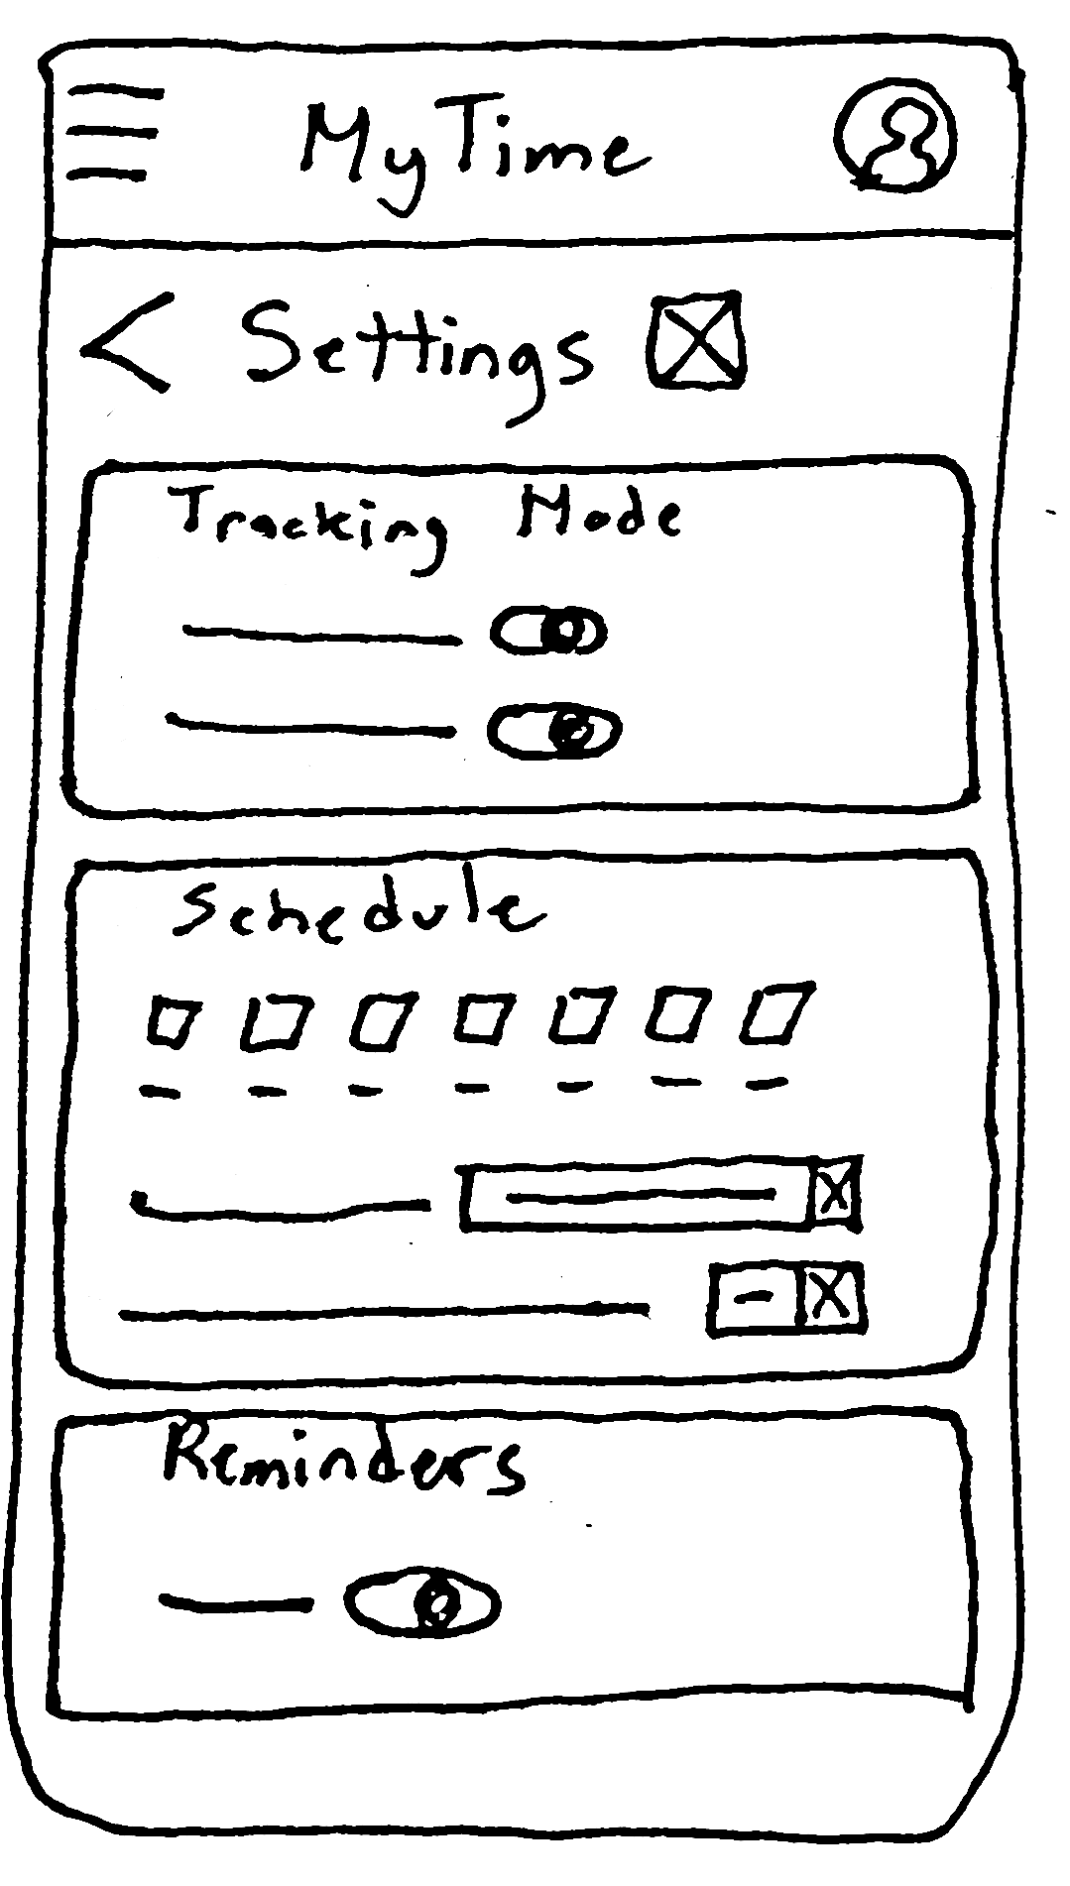
Paper wireframes
As I sketched design ideas for the Settings screen, which is how users can set automatic timekeeping, I thought about each step the user takes through their workday. The screen designs need to make timetracking and settings customizations easier for users.
Series of paper wireframes showing iterations of designs, getting closer to meeting user needs.
Stars indicate design elements to keep for future iterations.

Slide 13
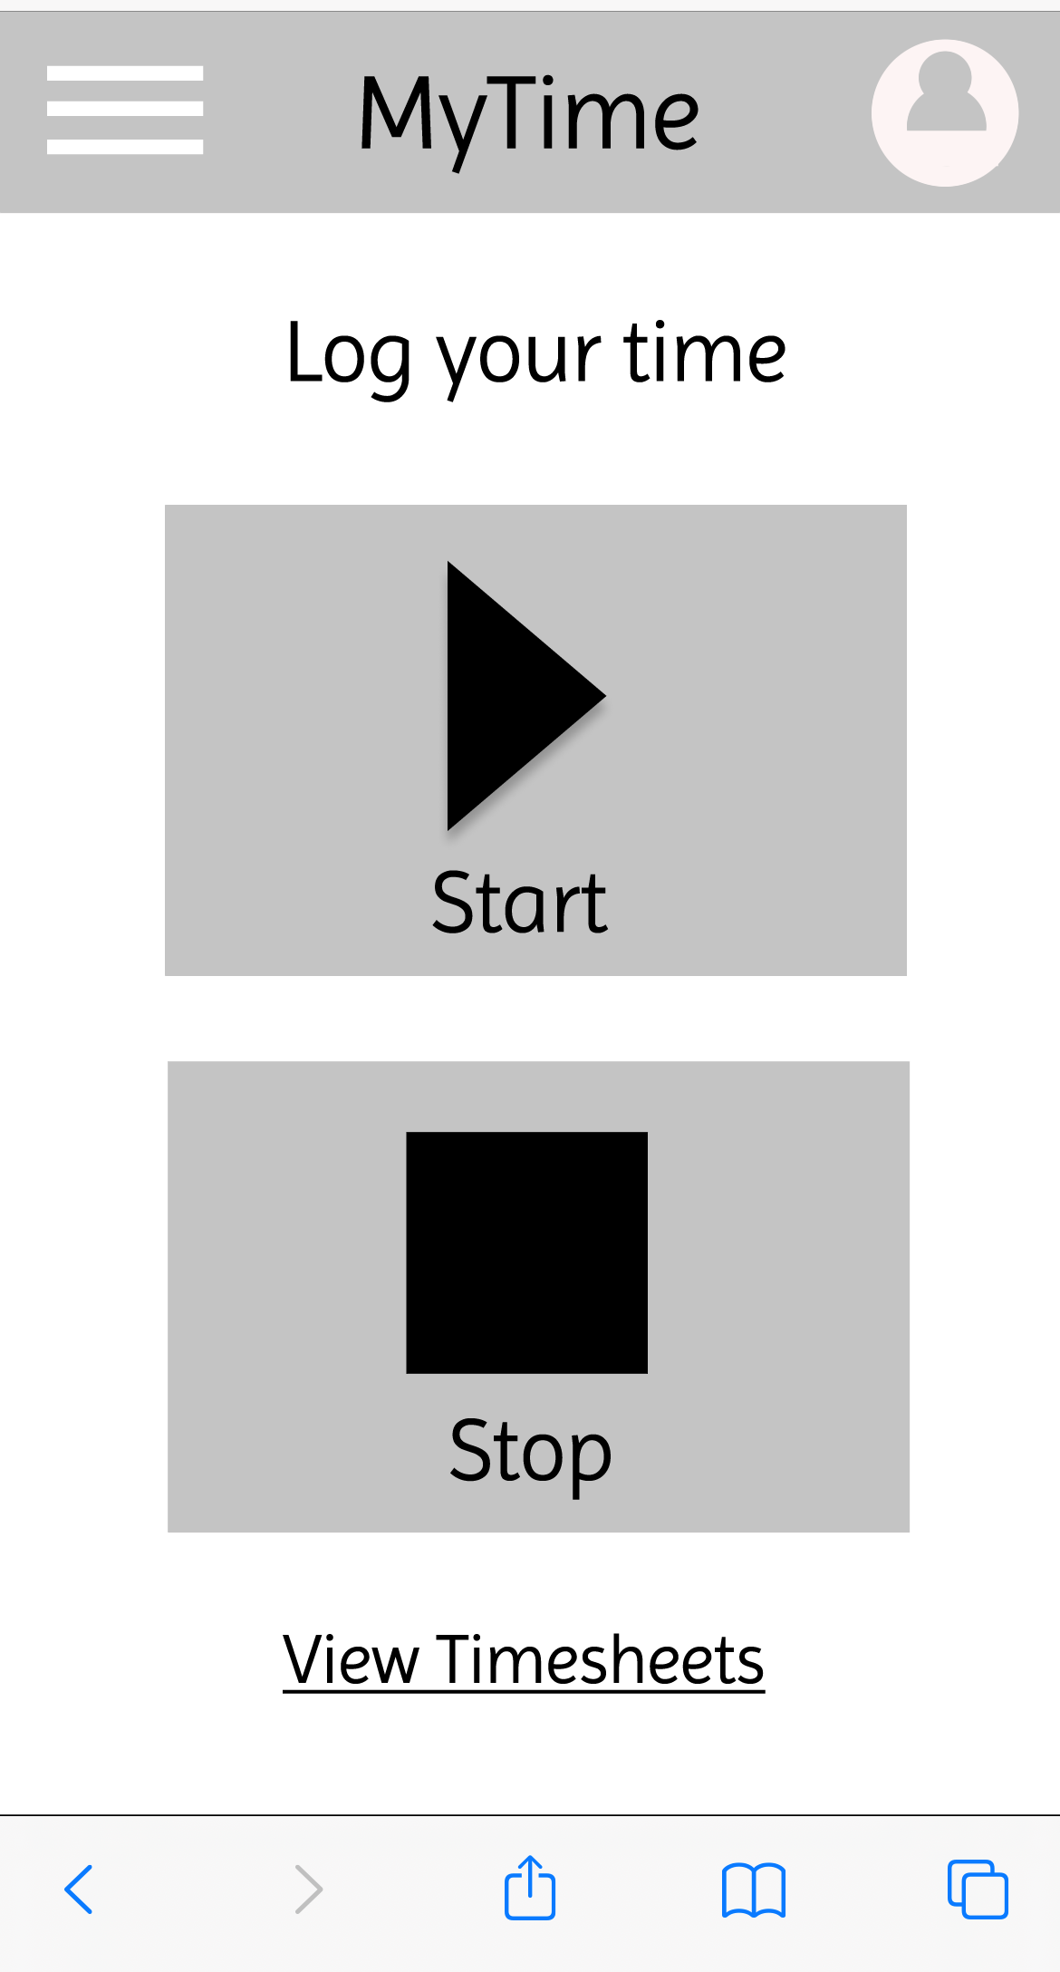
Digital wireframes
Wireframes were created in Figma to illustrate how the app would work. Users needed to quickly access the start/stop timer to easily log their work time. So, providing these controls directly on the home screen and using large clearly marked buttons allow users to easily access this functionality while on-the-go.
Insert second wireframe example that demonstrates design thinking aligned with user research
The primary goal of the app is to log time, so this functionality was placed on the home screen.
The buttons are large with clearly recognizable symbols and text labels, so employees can easily use the buttons, even while on-the-go and in various lighting conditions.

Slide 14
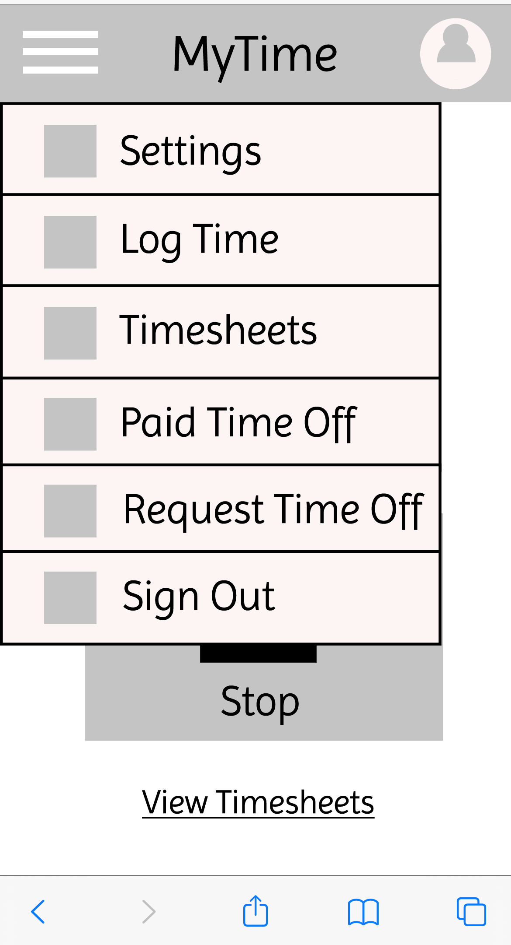
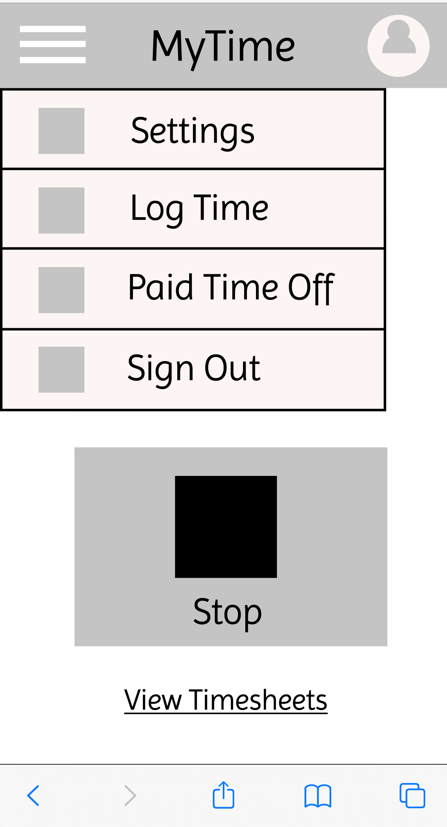
Digital wireframes
Hamburger menu can be reached from any screen in the app if the user needs to quickly change tasks
Wireframes were created in Figma to illustrate how the app would work. A hamburger menu was designed for the app so that users completing various tasks could easily find the option they need, no matter where they are in the app.
Insert first wireframe example that demonstrates design thinking aligned with user research
Employees often need to view the entire timesheet for the current week or previous week. Providing this link on the home page allows for easy access to this information

Slide 15
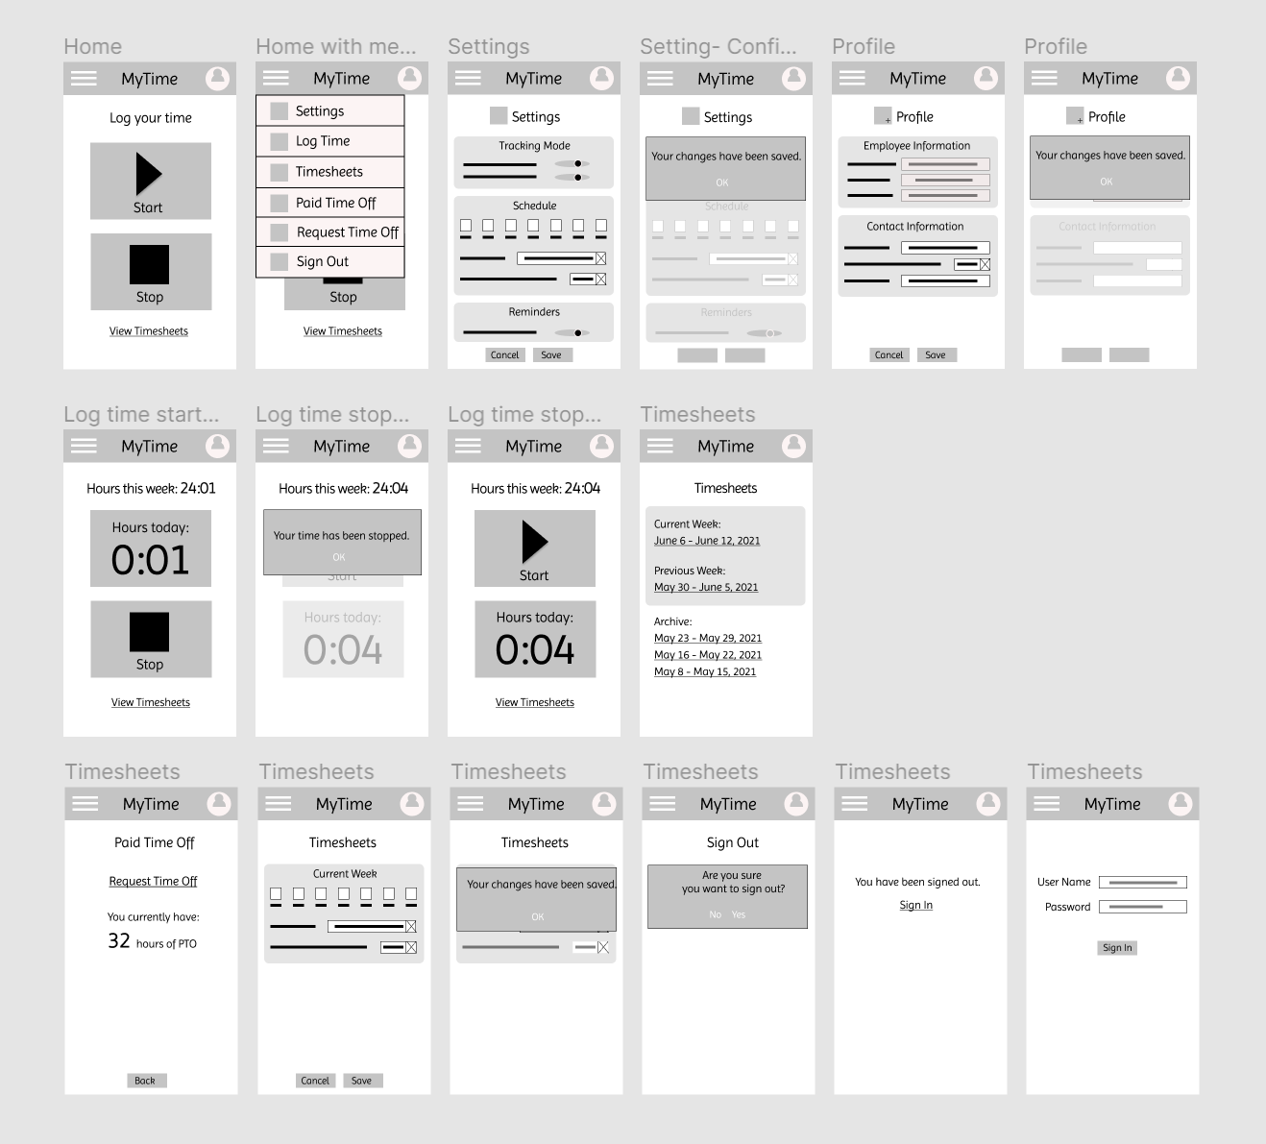
Low-fidelity prototype
Wireframes were designed for the main user flows and interactions were created between the screens so we can visualize how the app would be navigated.
Link to Low-Fidelity Prototype

Slide 16
Usability study: parameters
Study type:
Moderated Usability Study of Prototype
Location:
In users’ homes in Virginia
Participants:
5 hospital employees: 3 female, 2 male Age ranging from 30s to 50s
Length:
Over two days, in five 20-minute sessions

Slide 17
Usability study: findings
1
2
3
4
It is easy to log time manually
Users found the hamburger menu easy to use
It is helpful to have the option to request time off through the phone app
It is important to view the list of timesheets
Users found it very easy to start and stop logging their time manually on the home screen.
Users found it very easy to access requested tasks through the hamburger menu.
Users found it helpful to be able to request time off through the phone app, instead of having to rely on the desktop computer at work.
Most users found it important to be able to see a list of the current and recent previous timesheets

Slide 18
Refining
the design
Mockups
High-fidelity prototype
Accessibility

Slide 19
Mockups
Before usability study
After usability study
Users indicated that it was important to view timesheets and request time off, and they displayed comfort with using the hamburger menu. So, I added the “Timesheets” and “Request Time Off” options to the menu.
Mockup 1 before
Mockup 1 after

Slide 20
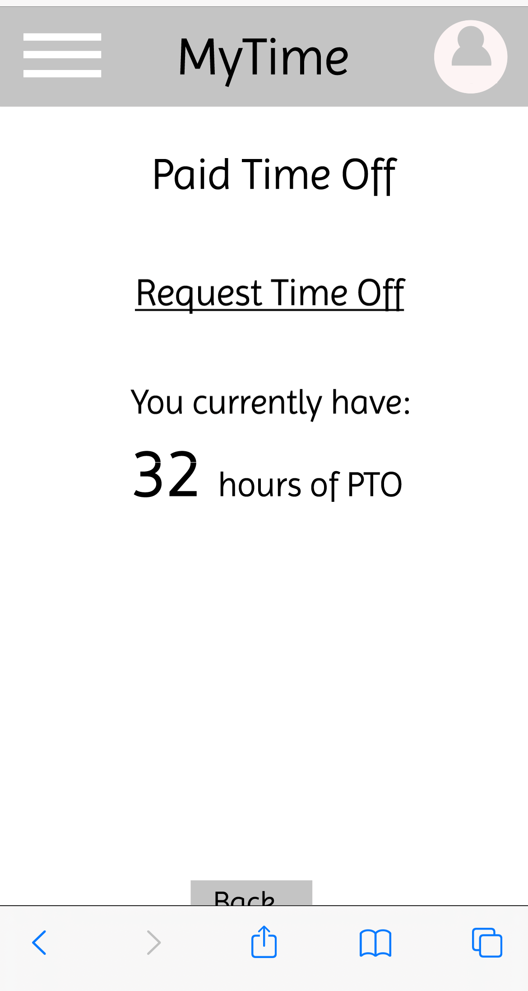
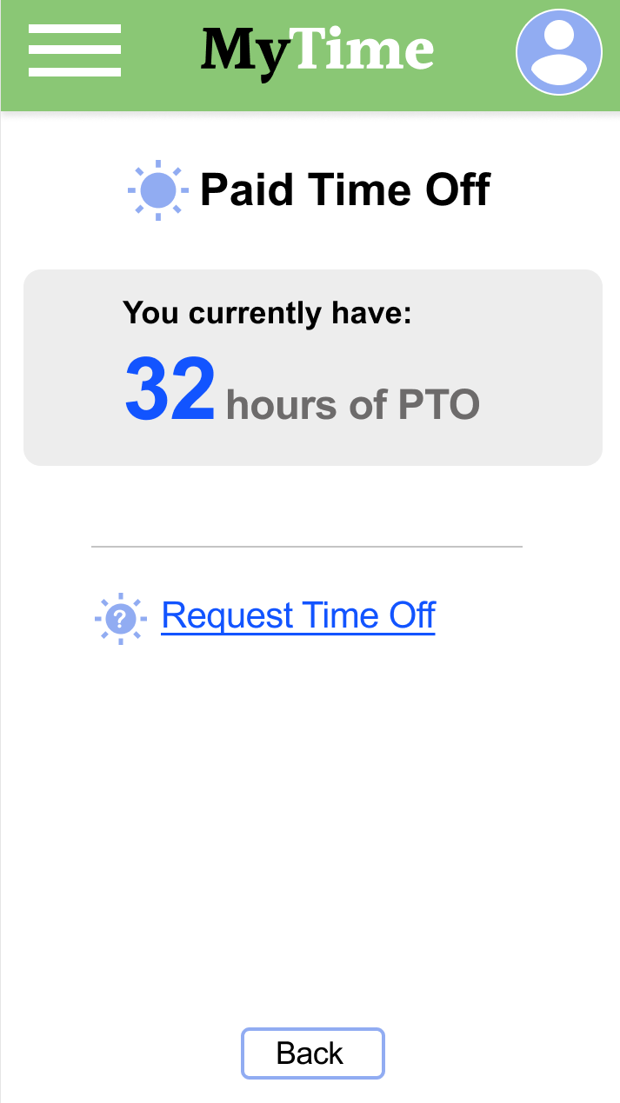
Before usability study
After usability study and design iterations
Mockups
Mockups were refined based upon the usability studies, as well as accessibility considerations and design principles. Through multiple iterations, the mockups became high fidelity, and incorporated various Gestalt principles.
Mockup 2 before
Mockup 2 after

Slide 21
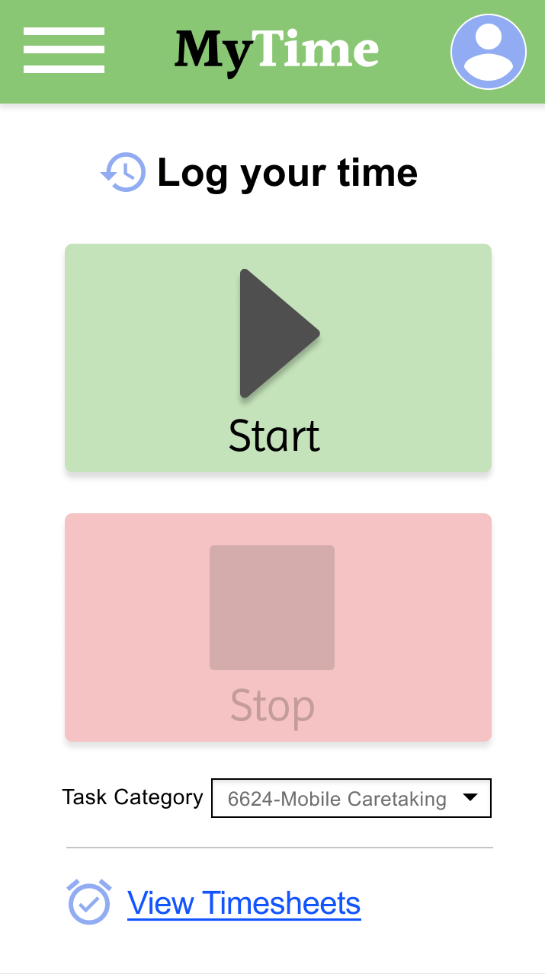
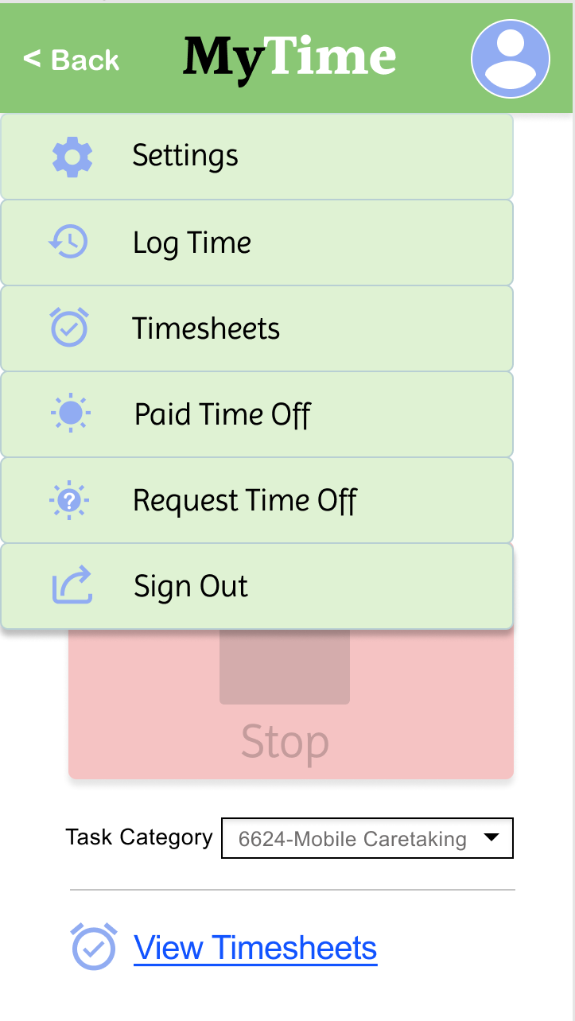
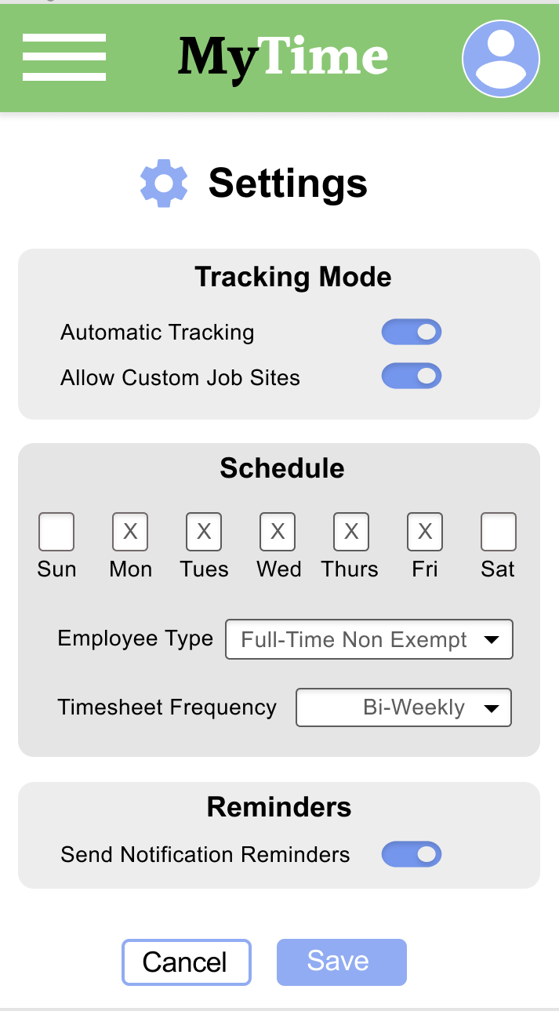
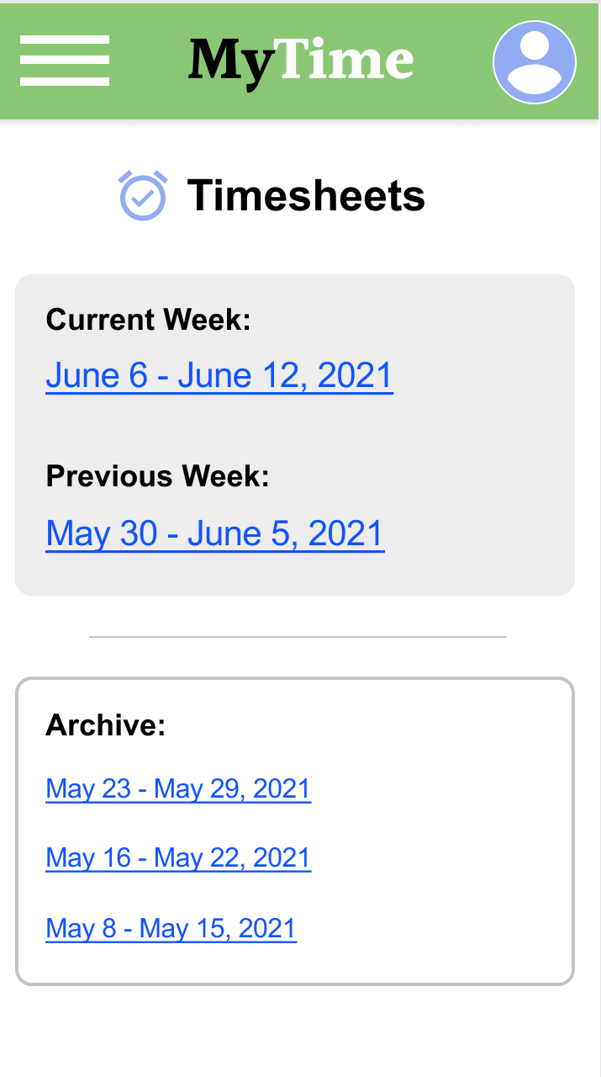
Mockups
Main mockup screen for display
Main mockup screen for display
Main mockup screen for display

Slide 22
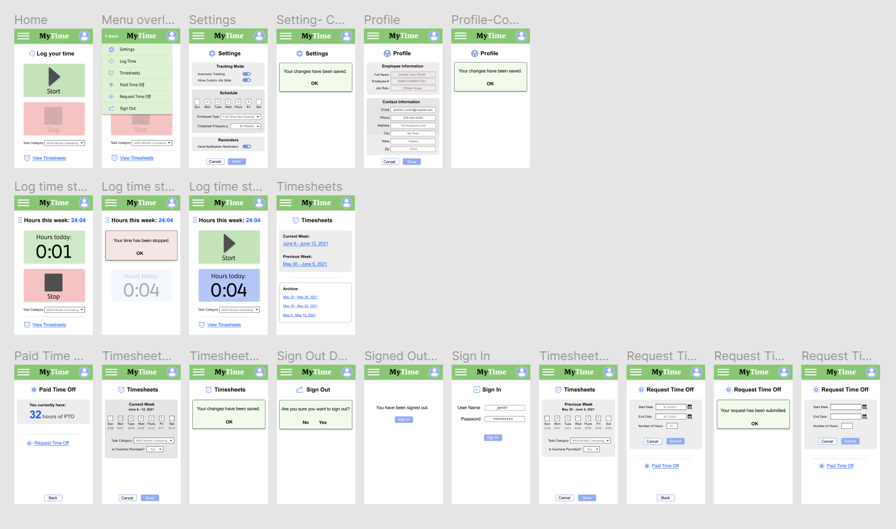
High-fidelity prototype
Link to high-fidelity prototype

Slide 23
Accessibility considerations
1
2
3
The buttons for logging time are large and easy-to-use, particularly for employees who may be on-the-go, distracted, or in different environments. Using a combination of symbols, color, and labels to mark the Start and Stop buttons allow for various users to utilize.
The app is organized clearly. Each screen is easily identified with a bold header, and the information below is organized logically so that users of varying abilities and using accessibility devices can easily navigate the app.
Visual elements such as icons and contrast ratios have been considered. Icons help users navigate and recognize the various tasks to complete within the app. Contrast ratios have been tested so that content can be read by those with visual impairments.

Slide 24
Going forward
The design has been shown to be easy to use for common tasks
Next we will build out more advanced features, such as GPS tracking and specification of custom job sites

Slide 25
Takeaways
Impact:
The app makes it easy for hospital employees with irregular work hours and multiple job sites to keep track of their hours while on-the-go. This improves efficiency for the employees, as well as for timekeeping administrators.
“I wish MY timesheet app was this easy!” -user
What I learned:
I learned that, by listening to and understanding real users, one can help solve their pain points with simple design changes.

Slide 26
Next steps
1
2
3
Further user testing for more advanced tasks in the app, such as setting job site locations with GPS
Build out this GPS capability based upon the user feedback
Share updates with the stakeholders and begin product development

Slide 27
Let’s connect!
Please contact me if you would like to review additional design work.
jenlycke@gmail.com www.JenniferLyckeUX.com

Slide 28
Thank you!

